Slide 1
Keegan Moyer Manager, Transmission Expansion Planning
WECC Response to DOE Quadrennial Energy Review
June 19, 2014
San Francisco, CA

Slide 2
Why Is WECC Interested?
Load
Hydroelectric Availability
Cooling Water for Thermal
Resources
Water
Water Utilities
Agricultural Demands
Municipal Demands
Notes:
Load and resources depend on Water

Slide 3
What is WECC Doing to Connect Water and Energy?
Water
←→ Energy
Collaborate
Evaluate Study Case
Develop Scenario
Apply Research

Slide 4
10-Year Drought Study for WGA
Goal: Examine the impacts of higher temperatures, changes to the timing and quantity of precipitation and runoff
Result: Lack of hydro resources and not the high loads or restricted thermal operation may be the Western Interconnection’s biggest concern.
Notes:
What others have asked TEPPC to do…
Mention other studies conducted…compare pre vs. post-grant number of studies
1977 drought
Sandia National Lab
Argonne National Lab
NREL
WGA policy input
Other cases:
High EE/DR/DG
Expansion Cases – capital cost analysis

Slide 5
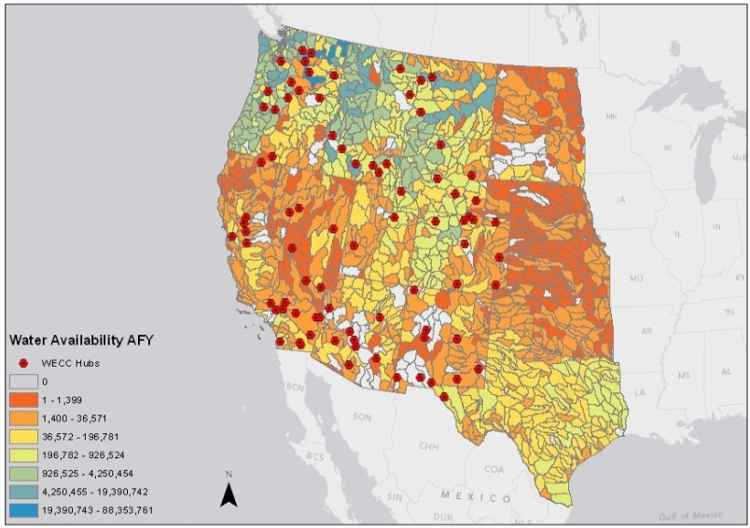
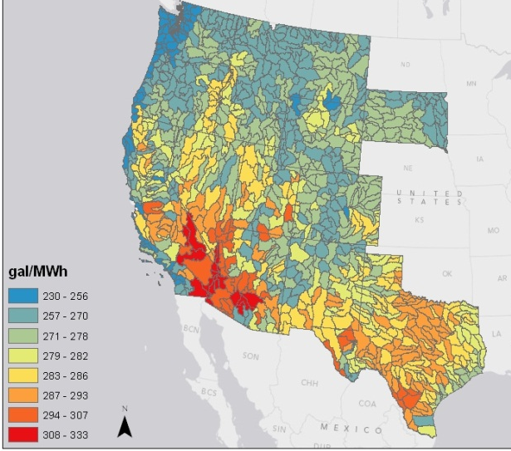
20-Year Tool Considers Water Constraints
Water Availability
Water
Use
Notes:
Intent
WGA-led effort
Water Availability for Generation
Water Types
Constraints and Costs
Dry Cooling Alternatives
Water Constrained Generation Hubs

Slide 6
Next Steps
WECC
Government
Water Resource Groups
Water and Energy Utilities
Transmission Owners, Operators, Developers
NGOs
Tribes
Water
Energy

Slide 7
Questions
?
Keegan Moyer
Manager, Transmission Expansion Planning
Western Electricity Coordinating Council 155 North 400 West, Suite 200
Salt Lake City, Utah 84103
kmoyer@wecc.biz
(801) 819-7662

